Slide 1
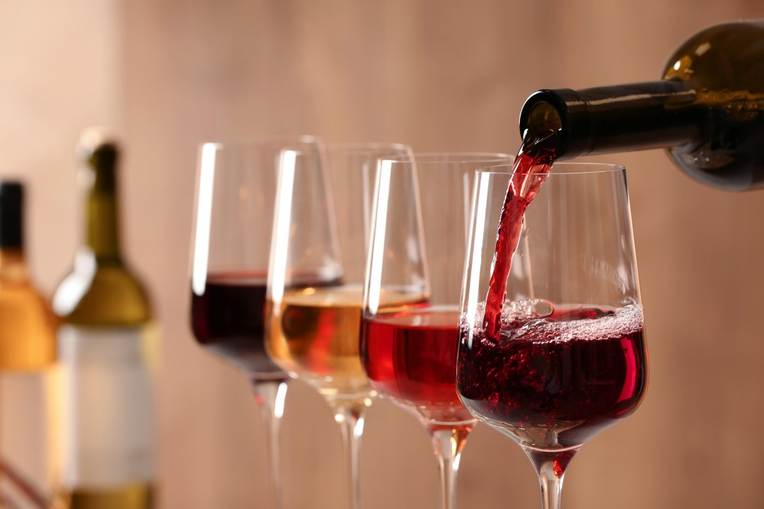
SP Project 2 Machine Learning
Wine Quality

Slide 2
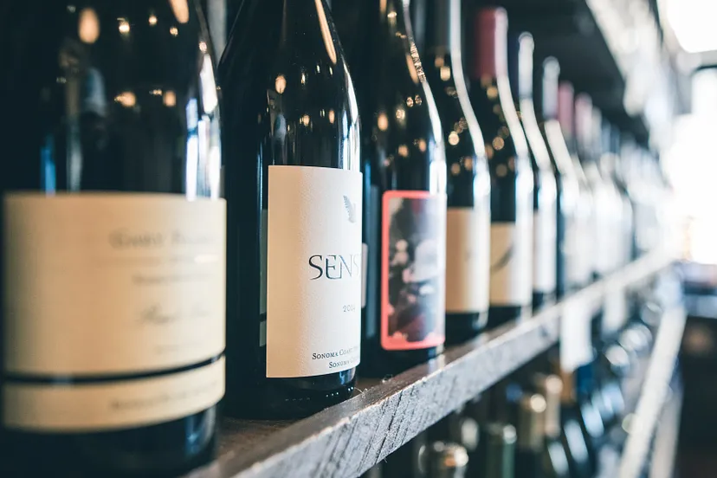
What Is Our Aim ?
Inspired by the success of ML in different sectors, here, we use it to predict the wine quality based on the various parameters.

Slide 3
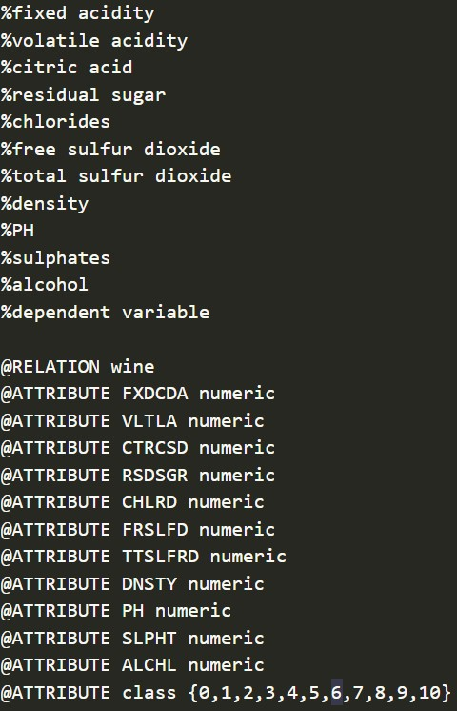
Introduction
Wine quality is crucial for producers in a competitive market. Historically, quality was determined by testing at the end of production, leading to wasted time and money if the wine was bad. Technology allows for testing during development, generating data about various parameters and their impact on quality. Machine learning (ML) can analyze this data to identify the most important parameters and predict wine quality, enabling producers to control quality and develop new brands.

Slide 4
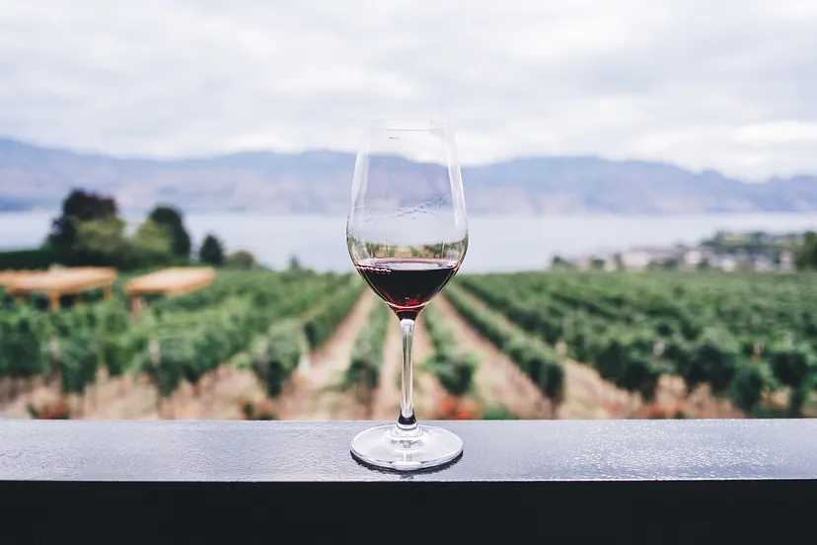
Description Atributes
Fixed acidity: Most acids involved with wine or fixed or nonvolatile (do not evaporate readily).
Volatile acidity: The amount of acetic acid in wine.
Citric acid: Found in small quantities, citric acid can add ‘freshness’ and flavor to wines.
Residual sugar: The amount of sugar remaining after fermentation stops.
Chlorides: The amount of salt in the wine.
Free sulfur dioxide: The free form of SO2 exists in equilibrium between molecular SO2 (as a dissolved gas) and bisulfite ion; it prevents microbial growth and the oxidation of wine.

Slide 5
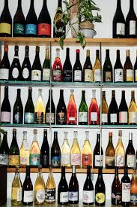
Total sulfur dioxide: Amount of free and bound forms of S02; in low concentrations, SO2 is mostly undetectable in wine, but at free SO2 concentrations over 50 ppm, SO2 becomes evident in the nose and taste of wine
Density: The density of a substance is its mass per unite volume
PH: Describes how acidic or basic a substance is on a scale from 0 (very acidic) to 14 (very basic)
Sulphates: A wine additive which can contribute to sulfur dioxide gas (S02) levels, wich acts as an antimicrobial and antioxidant
Alcohol: The percent alcohol content of the wine
Quality

Slide 6
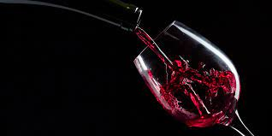
Descriptive Statistics of The Variables of The Wine Data
Variable Name | Mean | Standard Deviation | Minimum | Maximum
Fixed Acidity | 6.855 | 0.844 | 3.8 | 14.2
Volatile Acidity | 0.278 | 0.101 | 0.08 | 1.1
Citric Acid | 0.334 | 0.121 | 0 | 1.66
Residual Sugar | 6.391 | 5.072 | 0.6 | 65.8
Chlorides | 0.046 | 0.022 | 0.009 | 0.346
Free Sulfur Dioxide | 35.308 | 17.007 | 2 | 289
Total Sulfur Dioxide | 138.361 | 42.498 | 9 | 440
Density | 0.994 | 0.003 | 0.987 | 1.039
pH | 3.188 | 0.151 | 2.72 | 3.82
Sulphates | 0.49 | 0.114 | 0.22 | 1.08
Alcohol | 10.514 | 1.231 | 8 | 14.2

Slide 7
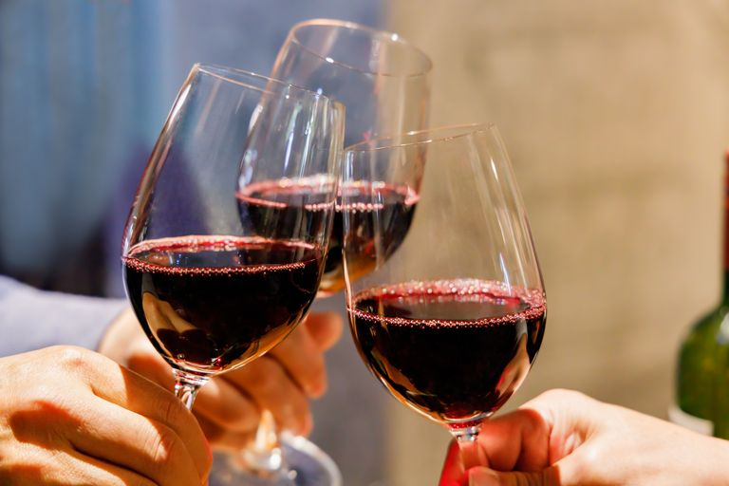
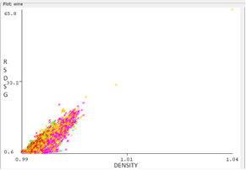
Relationship Between Attributes
Relationship Between Density and Residual Sugar
The image shows a scatter plot of density versus residual sugar for a set of wine samples. There is a strong positive correlation between residual sugar and density, meaning that wines with higher residual sugar levels tend to have higher densities. This is because sugar is more dense than water.
The data also shows that there are a few outliers, or data points that do not fit the general trend. These outliers may be due to errors in measurement or to the presence of other factors that are influencing the density or residual sugar of the wine samples.

Slide 8
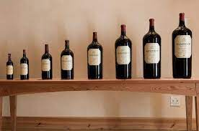
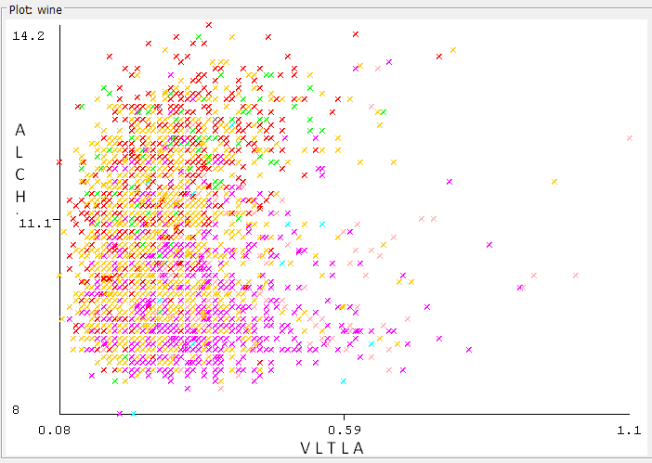
The plot shows a weak positive correlation between alcohol and VA. This means that as the alcohol content of a wine increases, the VA tends to increase as well, but the relationship is not very strong. There are many wines with high alcohol content that have low VA, and vice versa.
Here are some of the reasons why alcohol and VA may be correlated:
Both alcohol and VA are produced during fermentation. When yeast ferments sugar in grape juice, it produces alcohol and carbon dioxide. Some yeast strains also produce small amounts of acetic acid, which is the main component of VA.
Higher alcohol wines may be more susceptible to bacterial spoilage. Bacteria that can convert alcohol to acetic acid are more likely to grow in wines with higher alcohol content. This can lead to an increase in VA.
Relationship Between Alcohol and Volatile Acidity(VA)

Slide 9
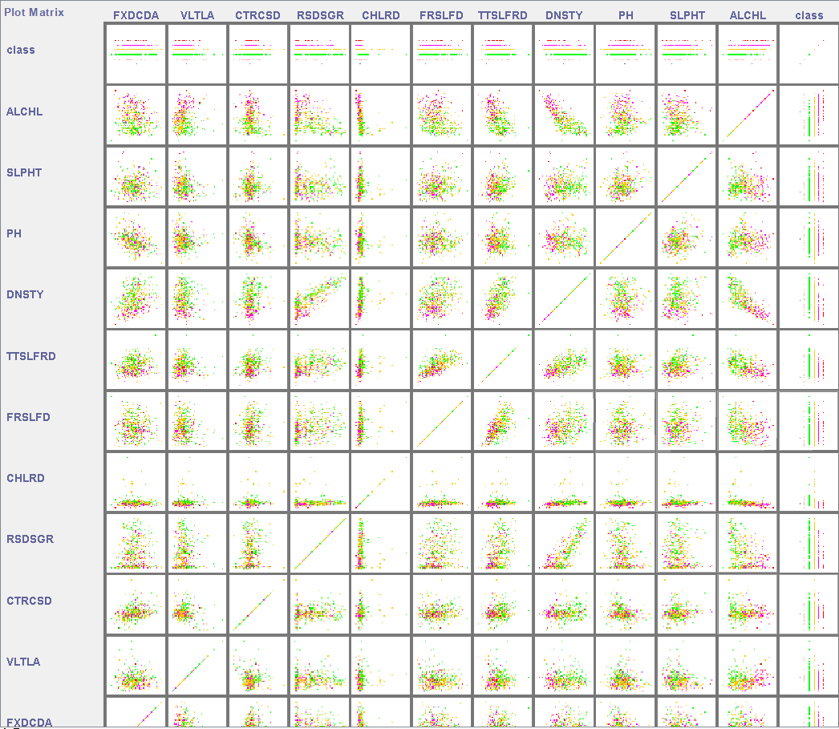
We see other relationships in the image.We can explain these one by one.

Slide 10
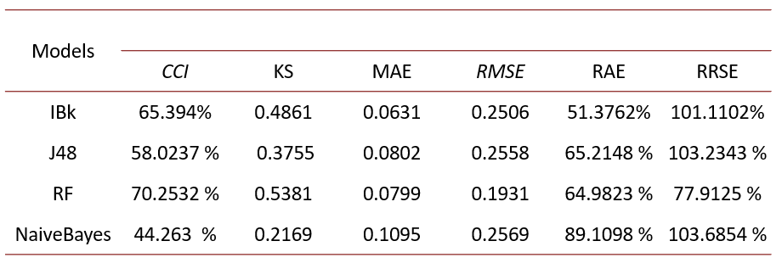
Machine Learning Algorithms
The models are:
IBk: K-nearest neighbors
J48: C4.5 decision tree
RF: Random forest
NaiveBayes: Naive Bayes
Metrices for each model:
CCI: Correct classification rate
KS: Kappa statistic
MAE: Mean absolute error
RMSE: Root mean squared error
RAE: Relative absolute error
RRSE: Root relative squared error

Slide 11
Ibk(K-nearest Neighbors)
The IBk algorithm, short for Instance-Based k-Nearest Neighbors, is a machine learning algorithm that falls under the category of lazy learning. Developed as part of the Weka machine learning software, IBk operates by storing all training instances in memory and classifying new instances based on their proximity to the k-nearest neighbors in the training set. The value of k represents the number of neighbors considered in the classification process.
J48(C4.5 decision tree)
The J48 algorithm, also known as C4.5, is a classic and widely used decision tree algorithm in machine learning. The J48 algorithm builds decision trees by recursively partitioning the dataset based on the values of different features, aiming to create subsets that are as homogenous as possible in terms of the target variable.

Slide 12
RF(Random Forest)
The Random Forest (RF) algorithm is a powerful and versatile ensemble learning method widely employed in machine learning for both classification and regression tasks.
Naive Bayes
The Naive Bayes algorithm is a probabilistic machine learning technique based on Bayes' theorem and the assumption of feature independence. Despite its simplicity, Naive Bayes has proven to be effective in various applications, especially in text classification and spam filtering. The algorithm calculates the probability of a particular class given a set of features by multiplying the conditional probabilities of each feature given the class.

Slide 13
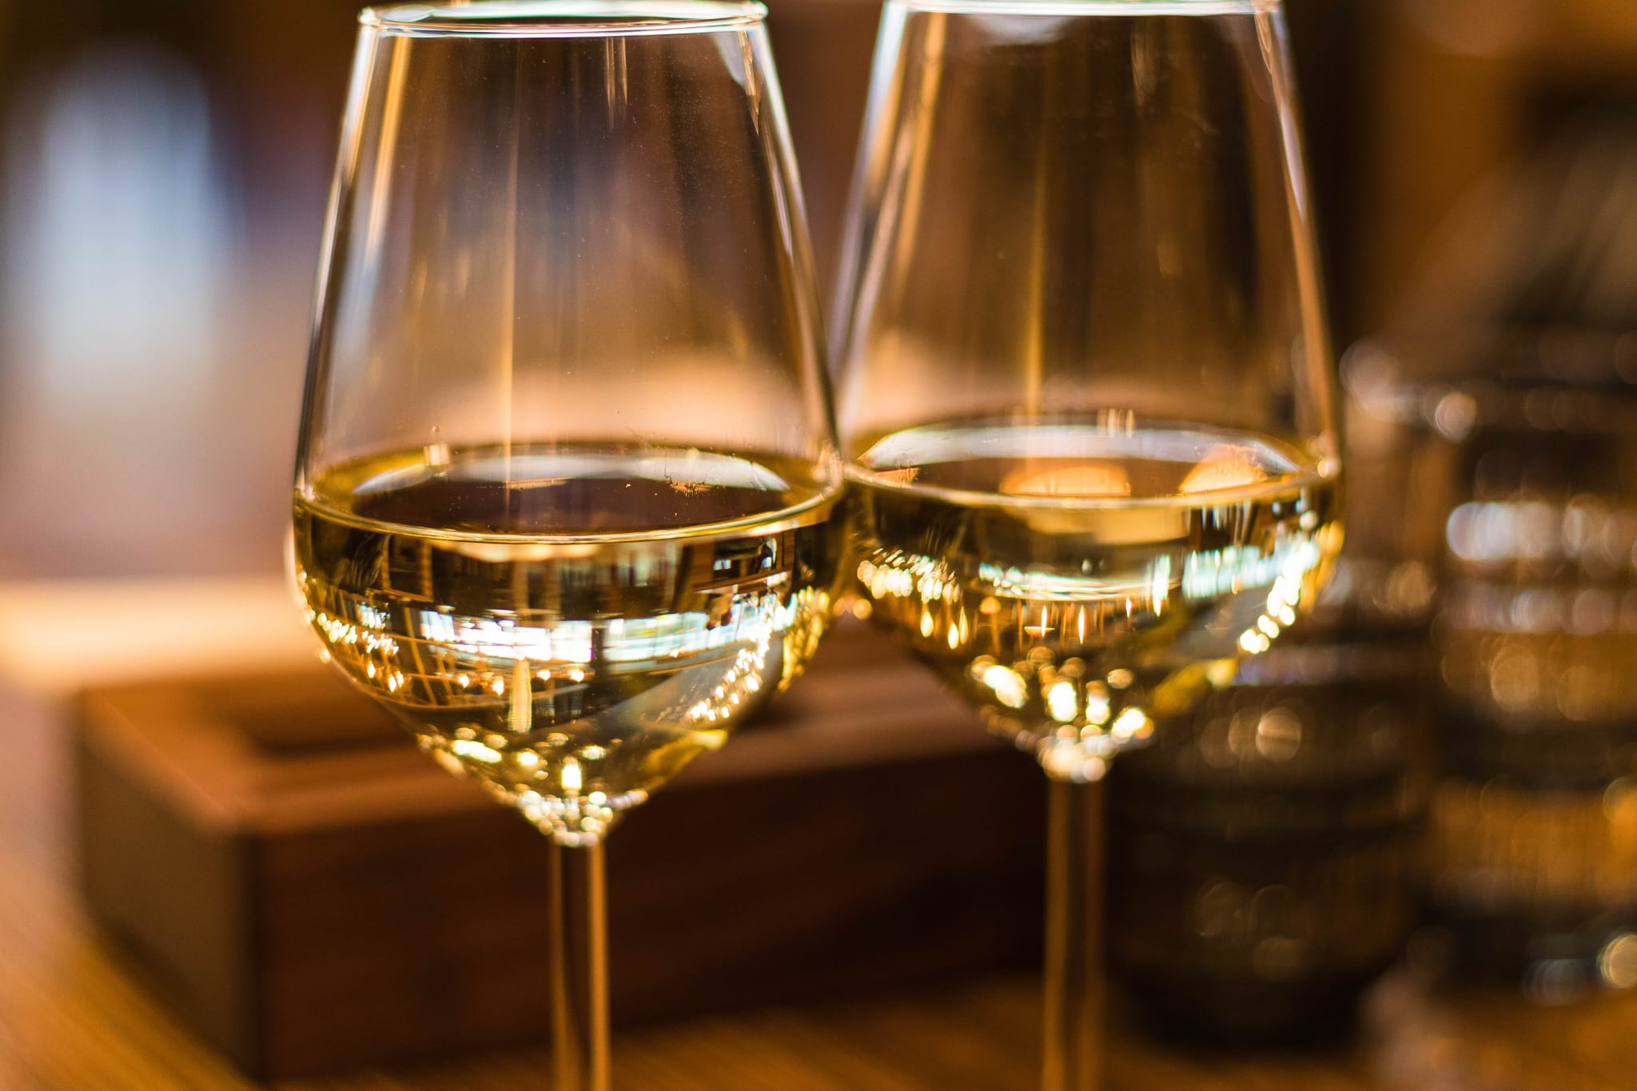
RESULTS
In this study, we compared four different machine learning models for predicting wine quality: K-nearest neighbors (IBk), C4.5 decision tree (J48), random forest (RF), and Naive Bayes. The RF model achieved the best performance on all metrics, with a correct classification rate of 70.25%, a Kappa statistic of 0.5381, a mean absolute error of 0.0799, a root mean squared error of 0.1931, a relative absolute error of 64.98%, and a root relative squared error of 77.91%. These results suggest that the RF model is a promising approach for predicting wine quality.

Slide 14
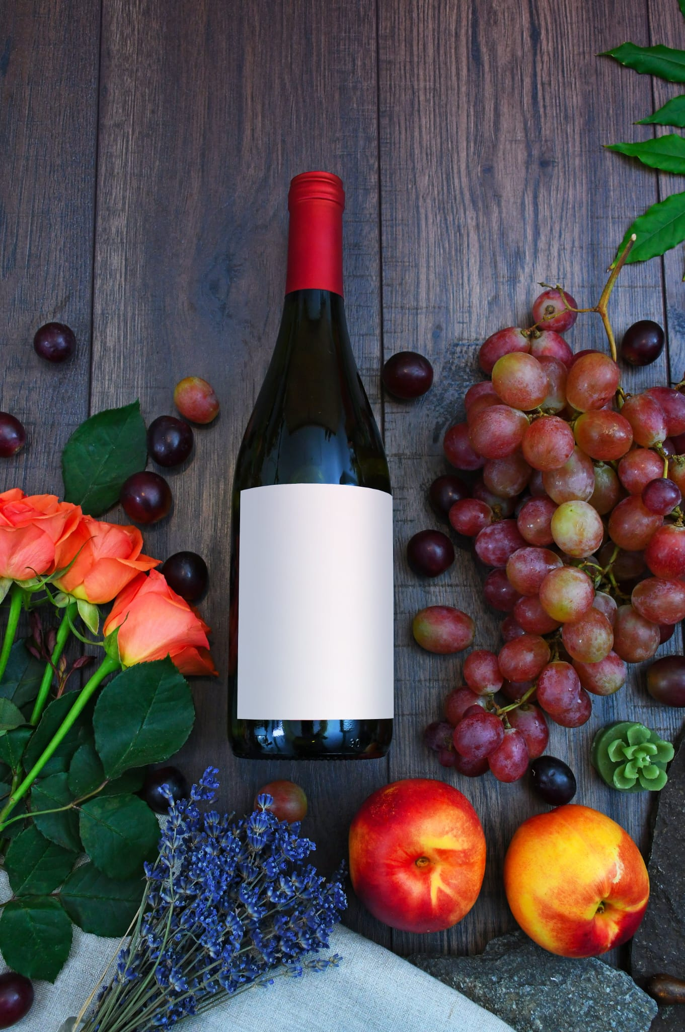
In future work, we plan to investigate the use of other machine learning models for predicting wine quality, as well as to explore the use of feature selection and ensemble methods to improve the performance of our models. We also plan to investigate the use of our models to predict other wine quality attributes, such as aroma and taste.

Slide 15
Conclusion
This work demonstrated that various statistical analysis can be used to analyze the parameters in the existing dataset to determine the wine quality. Based on various analysis, the wine quality can be predicted prior to its production.
Based on various analysis, the wine quality can be predicted prior to its production. Our work shows that among various ML models, Random Forest (RF) performs best to predict the wine quality.
This work shows an alternative approach that could be used to get the wine quality and, hence it can be a good starting point to screen the variables on which the wine quality depends.

Slide 16

End & References
Dataset:https://www.kaggle.com/code/nikunjmalpani/wine-quality-prediction-imbalanced-data
Hatice Süheyla ESER 22290689
Mustafa Enes CUNEDİOĞLU 21290422

